Slide 1




Influence of ocean acidification on DNA methylation patterns in geoduck
Shelly Trigg, Ph.D.
School of Aquatic and Fishery Sciences
University of Washington
Collaborators: Putnam HM, White SJ, Spencer L, Vadopalas B, Natarajan A, Hetzel J, Jaeger E, Soohoo J, Goetz FW, Gallardo-Escárate C, Roberts SB
Notes:
This is a multi-year collaboration with Illumina, 10x Genomics, and Phase Genomics

Slide 2
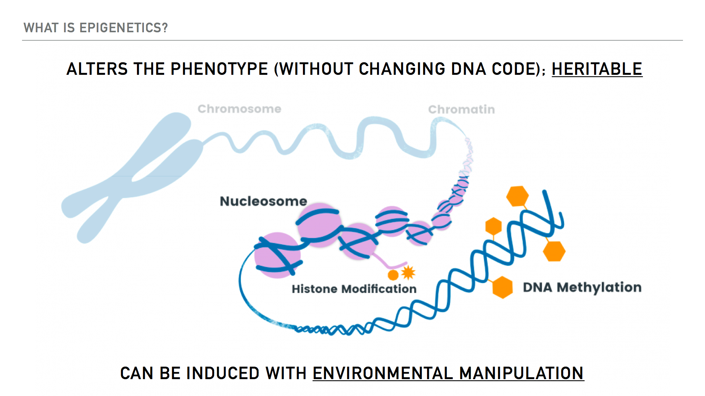

Slide 4
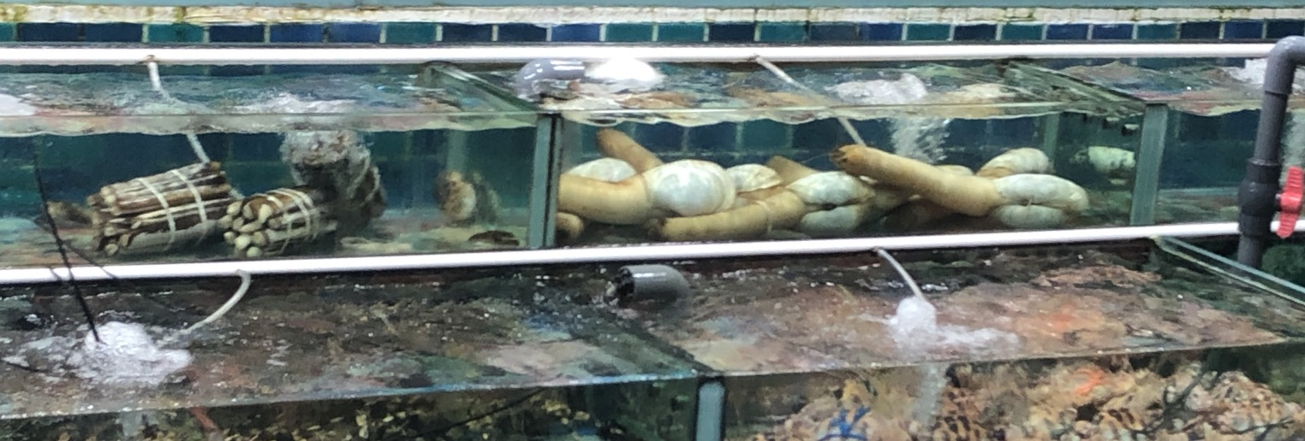
Geoduck (Panopea generosa)
Among most valuable farmed shellfish on a per acre basis
>$20 M in annual sales in Washington alone

Slide 5
Geoduck (Panopea generosa)
Genomic Resources
Identification of potential epigenetic markers underlying beneficial traits

Slide 6
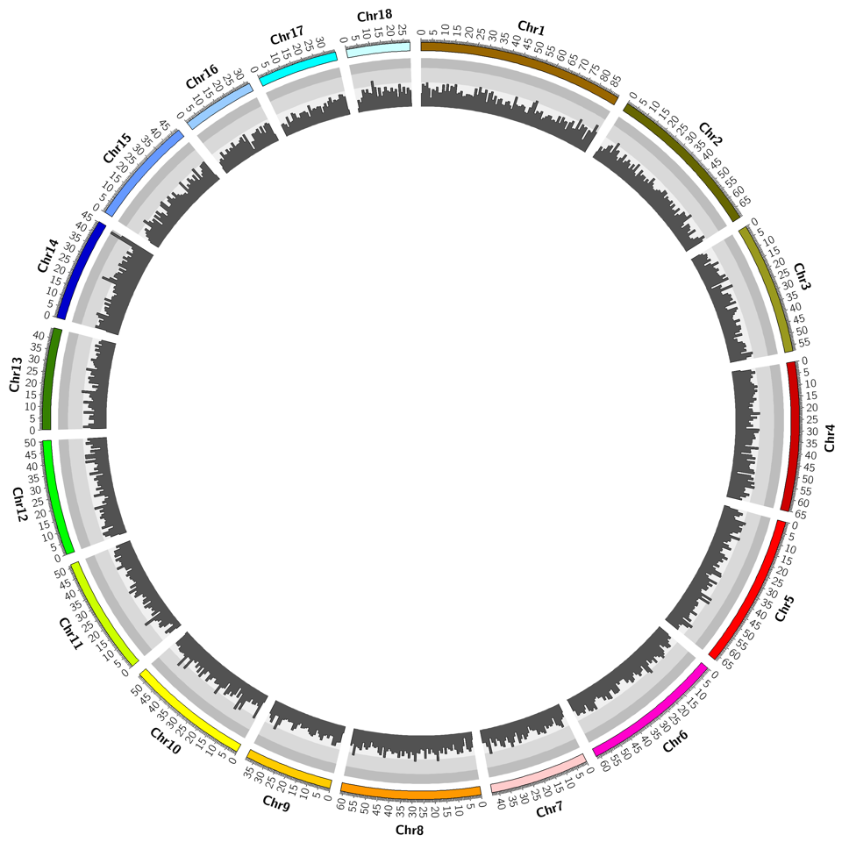
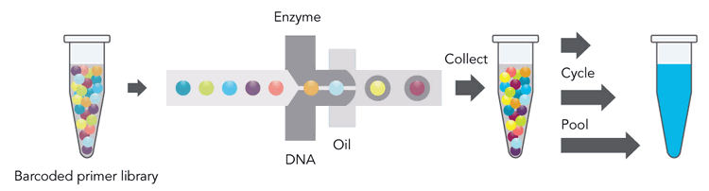
Draft Genome Assembly
10x Genomics
Linked-reads sequencing
Phase Genomics
Proximo Hi-C
18 Scaffolds
34,947 Genes
565,711 retro elements
259,955 transposons
42,601 sRNA
CpGs

Slide 7
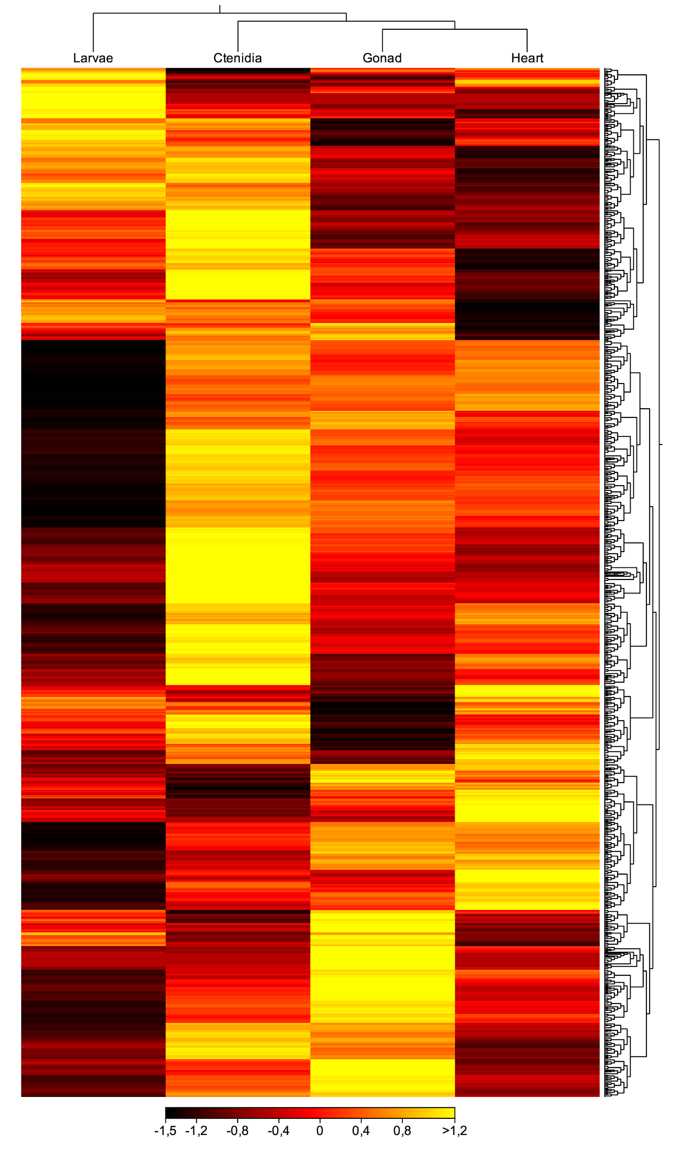
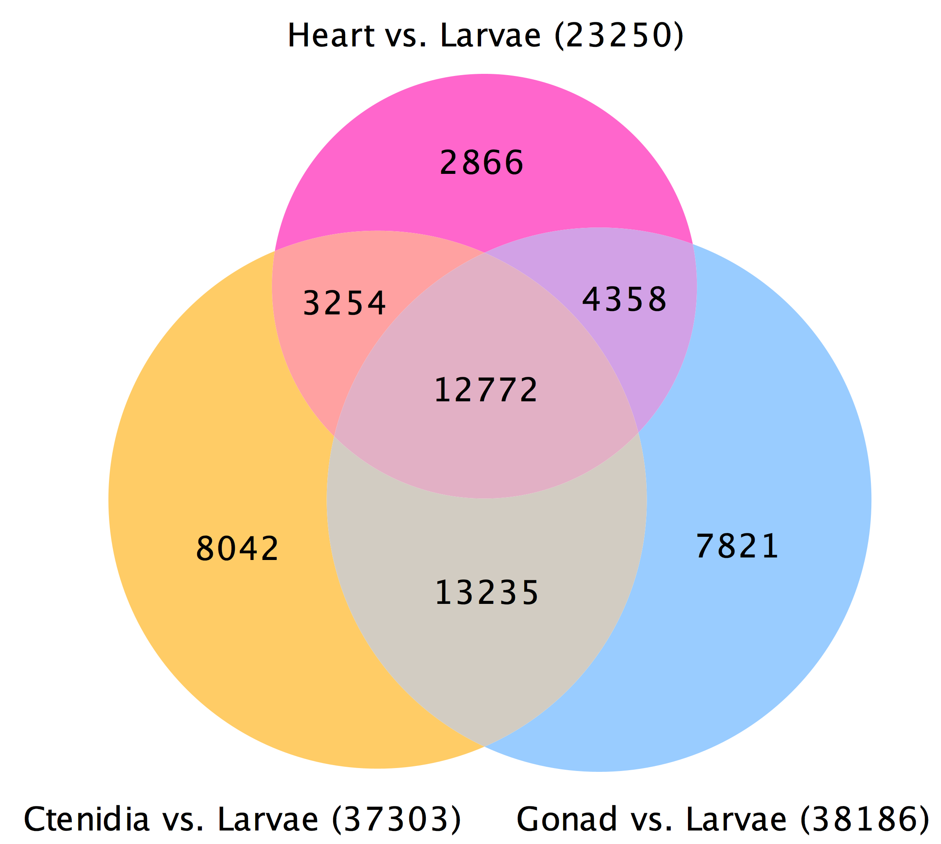
Long non-coding RNA

Slide 8
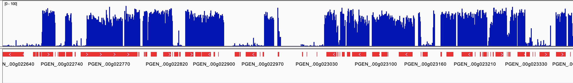
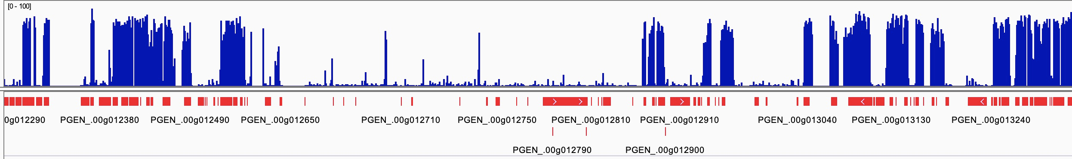
DNA Methylation Landscape

Slide 9
Geoduck (Panopea generosa)
Genomic Resources
Identification of potential epigenetic markers underlying beneficial traits

Slide 11

Altering early life environment pH
Initial Exposure
Common
Garden
Secondary Exposure
Ambient
Ambient
3 month old juveniles
Ambient
Low pH
Low pH
0
10
23
135
145
Days

Slide 12
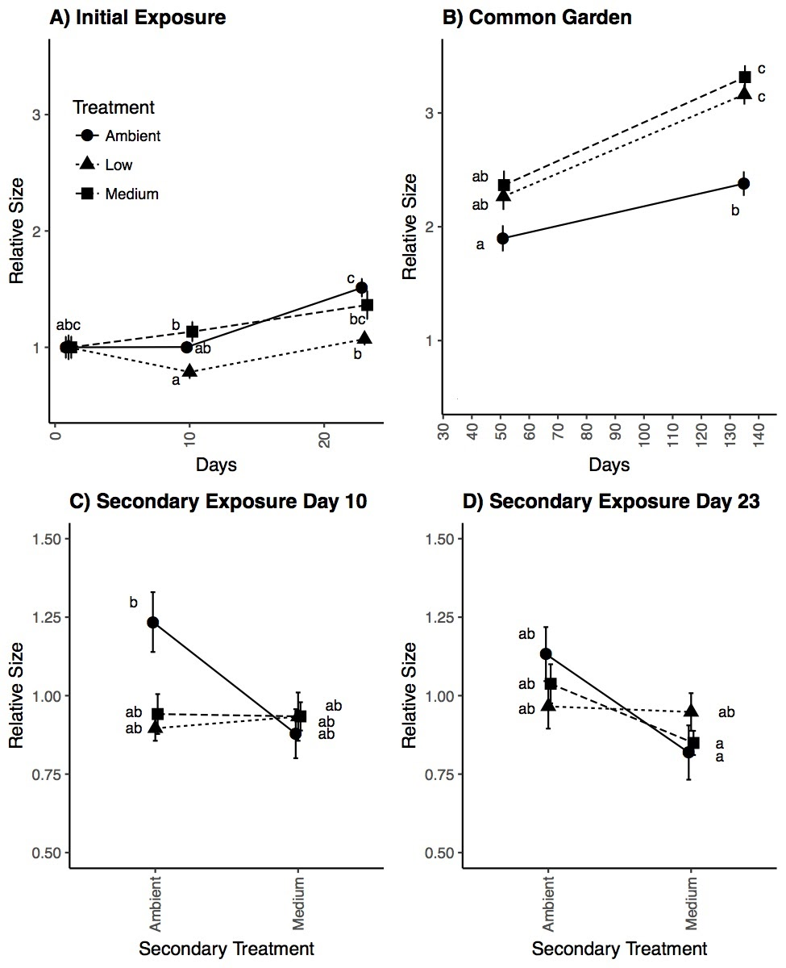
Initial low pH exposure leads to compensatory growth
pH 7.0
pH 7.4
Notes:
While there was no size during and after initial exposure, we saw initial low pH exposure led to compensatory

Slide 13
Does early pH exposure influence epigenetic marks that underlie compensatory growth phenotype?

Slide 14
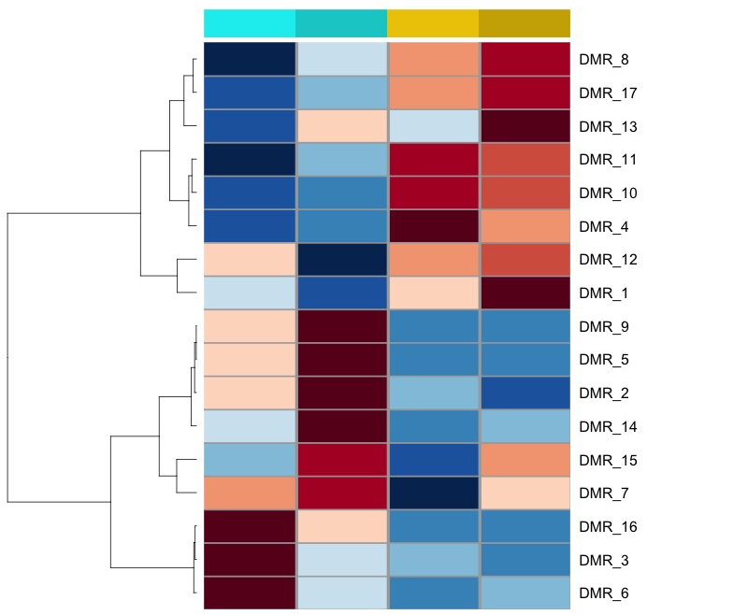
Initial low pH methylation marks persist
Initial exposure
ambient
low ph
initial exposure
common garden
initial exposure
common garden
Increased methylation
persists
Decreased methylation persists

Slide 15
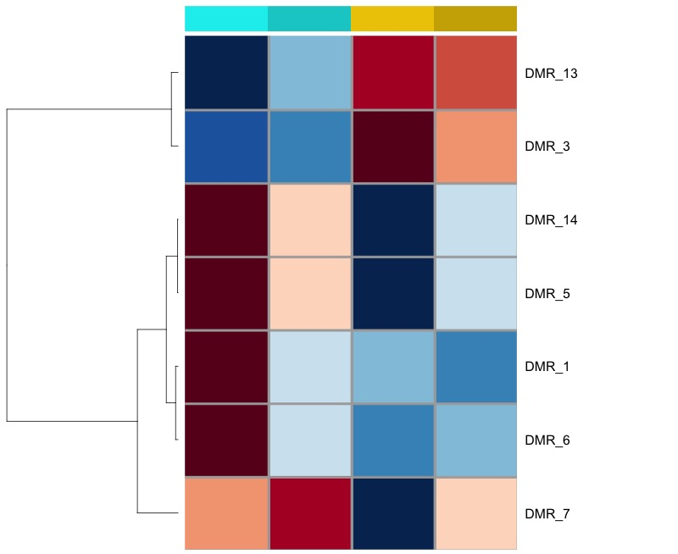
Initial low pH methylation marks persist
Initial exposure
ambient
low ph
initial exposure
common garden
initial exposure
common garden
Increased methylation
persists
Decreased methylation persists

Slide 16
Initial low pH methylation marks persist
DMR_ID | Location | Methylation Change relative to ambient | Feature Type | Feature Name | distance | function
DMR_1 | Scaffold_01:42796927-42796976 | decrease | repeat | rnd-1_family-793 | 0 | no uniprot annotations
DMR_3 | Scaffold_01:59186898-59186958 | increase | gene | PGEN_.00g021750 | 0 | no uniprot annotations
DMR_5 | Scaffold_02:10983130-10983176 | decrease | repeat | rnd-1_family-826 | 0 | no uniprot annotations
DMR_7 | Scaffold_02:46872024-46872106 | decrease | repeat | rnd-5_family-2058 | 0 | no uniprot annotations
DMR_6 | Scaffold_02:28519662-28519931 | decrease | gene | PGEN_.00g043300 | 199 upstream | voltage sensitive calcium channel activity; large protein with multiple tissue specific isoforms (Annexin-7)
DMR_13 | Scaffold_03:56511986-56512009 | increase | repeat | rnd-6_family-1367 | 0 | no uniprot annotations
DMR_14 | Scaffold_04:40346615-40346636 | decrease | gene | PGEN_.00g094120 | 0 | no uniprot annotations
After initial exposure
After common garden
After initial exposure
After common garden
Initial exposure
ambient
pH 7.4

Slide 17
Does early pH exposure influence response to later stress?

Slide 18
Evidence for environmental hardening
Secondary low pH exposure DOES NOT negatively affect size of juveniles initially exposed to low pH
Initial Treatment
pH 7.0
pH 7.4
pH 7.4

Slide 19
Does early pH exposure influence epigenetic marks that underlie stress resistance phenotype?

Slide 20
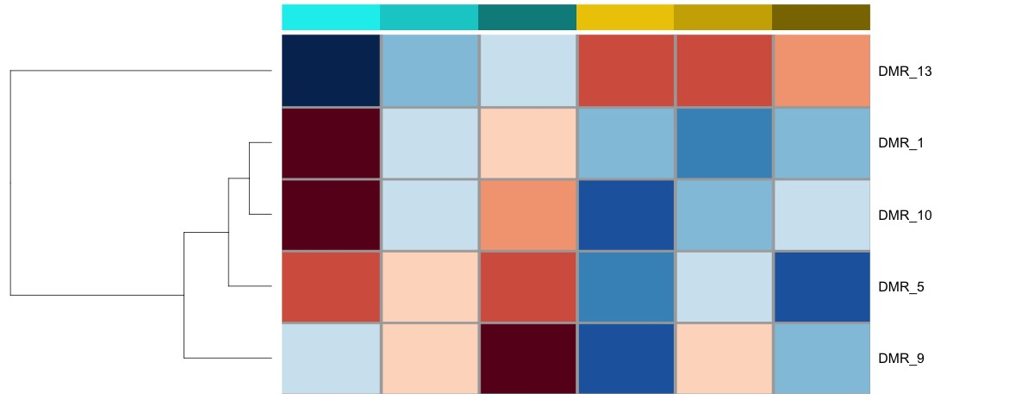
Potential epigenetic marks underlying environmental hardening
After initial exposure
After common garden
After
2nd exposure
After initial exposure
After common garden
After
2nd exposure
Initial exposure
ambient
pH 7.4
Increased methylation
persists
Decreased methylation persists

Slide 21
Summary
Identified positive growth phenotype
and potential associated epigenetic marks
Manipulated environmental pH
Notes:
We are currently carrying out experiments in collaboration with Jamestown S’klaalam Pt. Whitney Hatchery to investigate

Slide 22
Summary
Do these epigenetic marks exist in adults?
Identified positive growth phenotype
and potential associated epigenetic marks
Manipulated environmental pH
Notes:
We are currently carrying out experiments in collaboration with Jamestown S’klaalam Pt. Whitney Hatchery to investigate

Slide 23
Summary
Do these epigenetic marks exist in adults?
Currently carrying out pH experiments on adults and their offspring
Identified positive growth phenotype
and potential associated epigenetic marks
Epigenetic marks could be used to select wild adults that would yield more robust offspring
Shelly Trigg
strigg@uw.edu
Manipulated environmental pH
Presentation + Resources:
https://github.com/shellytrigg/talk-pag2020
Notes:
We are currently carrying out experiments in collaboration with Jamestown S’klaalam Pt. Whitney Hatchery to investigate

